Slide 1

Experimental economics
John Hey
Lecture 11
Me in Prague some years ago!

Slide 2
Decision-making under risk
Theories – start with axioms.
There are lots of theories based on different axioms.
We can do two things:
Test axioms and theories.
Fit preference functionals.

Slide 3
Expected utility theory
Says that decision-makers act on the basis of the utility that they expect to get.
(If the utility function is linear in money, and the outcomes are money, they act on the basis of the return that they expect to get – risk neutrality.)
It is based on axioms:
Completeness
Transitivity
Independence
Continuity

Slide 4
EU axioms
By a ‘(p-)mixture’ of two things, we mean a lottery which results in one of these things with probability p and the other with probability 1-p.
Completeness: given any two things, the DM can always say that one or the other is preferred, or he or she is indifferent.
Transitivity: If A is preferred to B and B preferred to C then A is preferred to C.
Independence: If A is preferred to B then a mixture of A with C is preferred to the same mixture of B with C.
Continuity: If A is preferred to B and B preferred to C then there must be a mixture of A and C for which there is indifference with B.

Slide 5





Axioms
Economists love axioms – definitions of ‘rationality’.
They are beautiful and intellectually appealing.
Consider the Independence Axiom.
Suppose you prefer A to B, where A and B can be anything.
Now suppose you are offered the following risky choice: between Left and Right. Which would you choose? C is anything. p is anything.
p
A
B
These are both risky choices with probabilities p and 1-p.
Left
Right
1-p
C
C

Slide 6








Now a test
                What would you choose here?
£400
0.8
£300
0.2
£0
                And here?
0.25
0.2
0.75
Are your decisions consistent with the Independence Axiom?

Slide 7
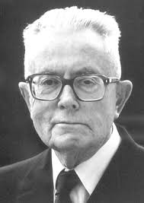
This is the Allais ‘paradox’
The Independence Axiom is the crucial part of Expected Utility theory.
Experimental tests of this axiom and others have led to the development of new theories of behaviour under risk, most notably Prospect theory and Rank-Dependent Expected Utility theory.
Allais (Nobel Prize 1988) was an early experimenter in the field.

Slide 8





The Marschak-Machina triangle
1
Used for portraying lotteries with 3 outcomes such that x₁ preferred to x₂ and x₂ is preferred to x₃. x₁ is the outcome with probability p₁, x₂ is the outcome with probability p₂ and x₃ is the outcome with probability p₃, Of course p₁+ p₂+ p₃ = 1.
0

Slide 9
Indifference curves in the MMT for EU
An indifference curve is given by
p₁u(x₁) + p₂u(x₂) + p₃u(x₃) = constant.
Denoting u(x_{i}) by u_{i}, i=1,2,3 and using p₁+ p₂+ p₃ = 1, we can write the equation of an indifference curve as:
p₁ = [(u₂-u₃)/ (u₁-u₂)]p₃ + constant.
This is an upward-sloping line in the MMT.

Slide 10
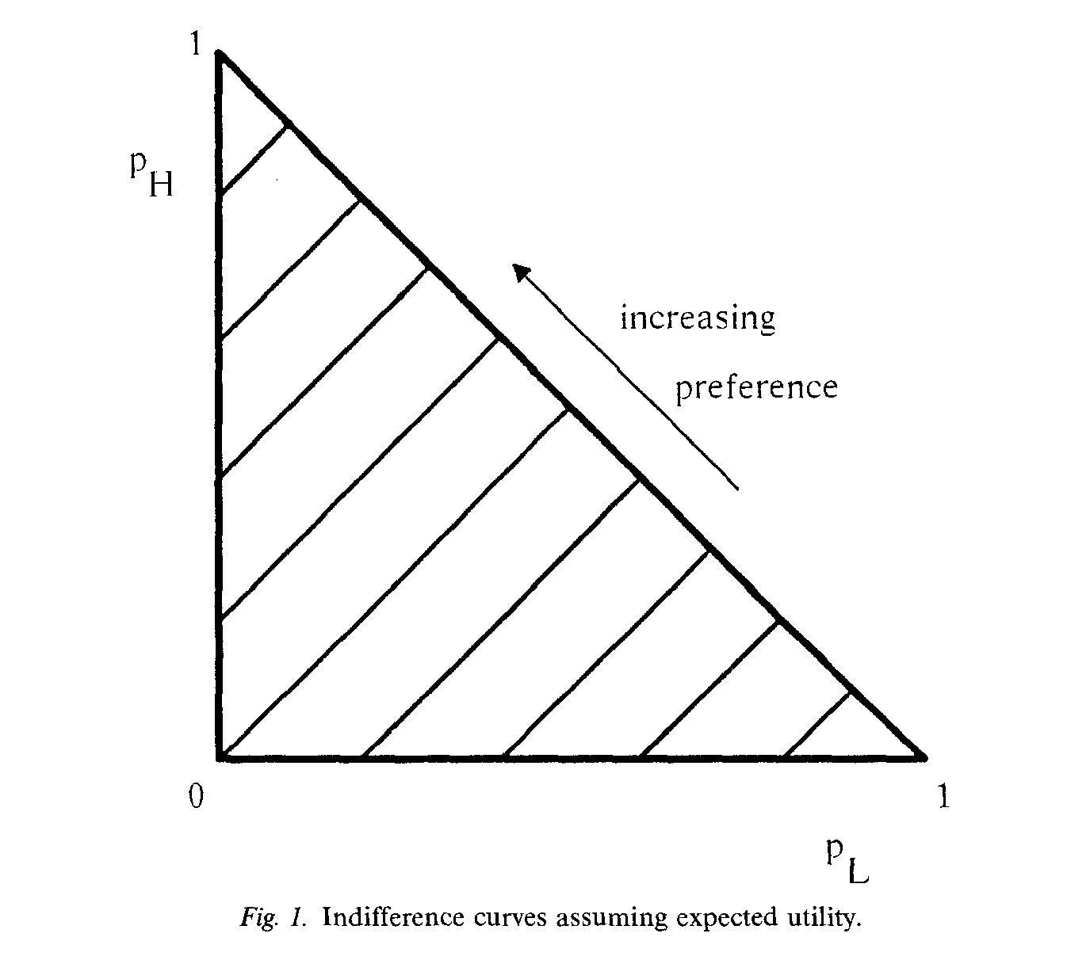

Slide 11
A Common Ratio Effect
Problem from above:
(1) Do you prefer (A) £300 for sure, or (B) a lottery which yields £400 with probability 0.8 and £0 with probability 0.2?
(2) Do you prefer (A) a lottery which yields £300 with probability 0.25 and £0 with probability 0.75, or (B) a lottery which yields £400 with probability 0.2 and £0 with probability 0.8?
A preference for A in problem 1 and for B in Problem 2 is a violation of the Indpendence Axiom and hence of Expected Utility theory.

Slide 12
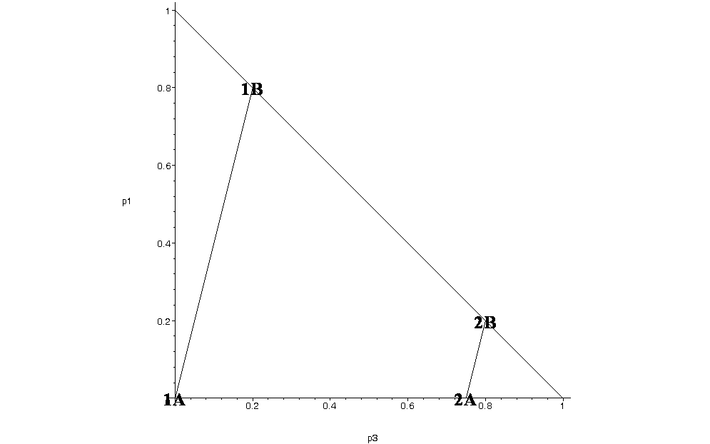
Common ratio effect in the mmt

Slide 13
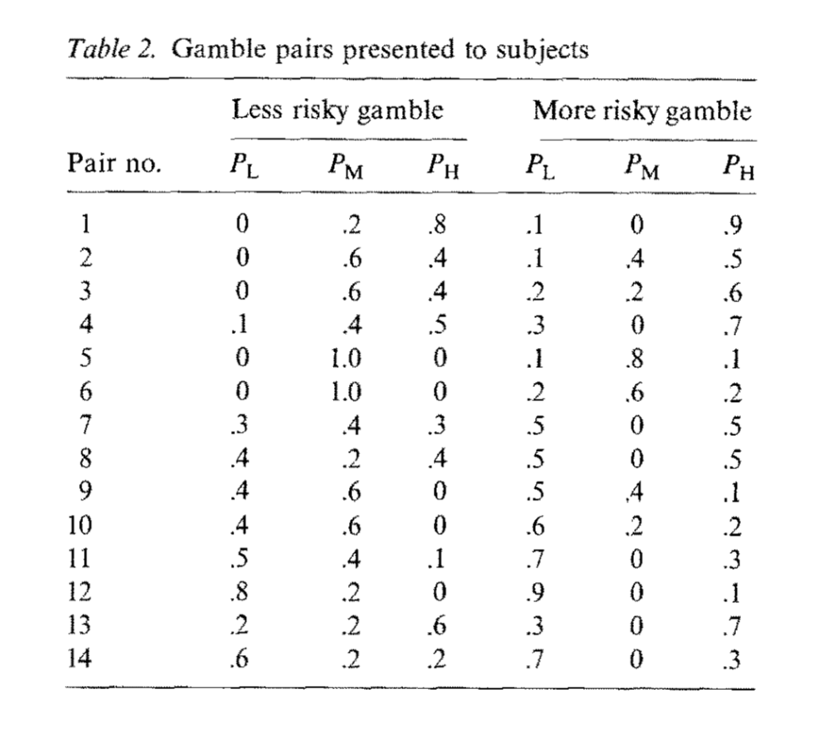
Camerer (1989)

Slide 16
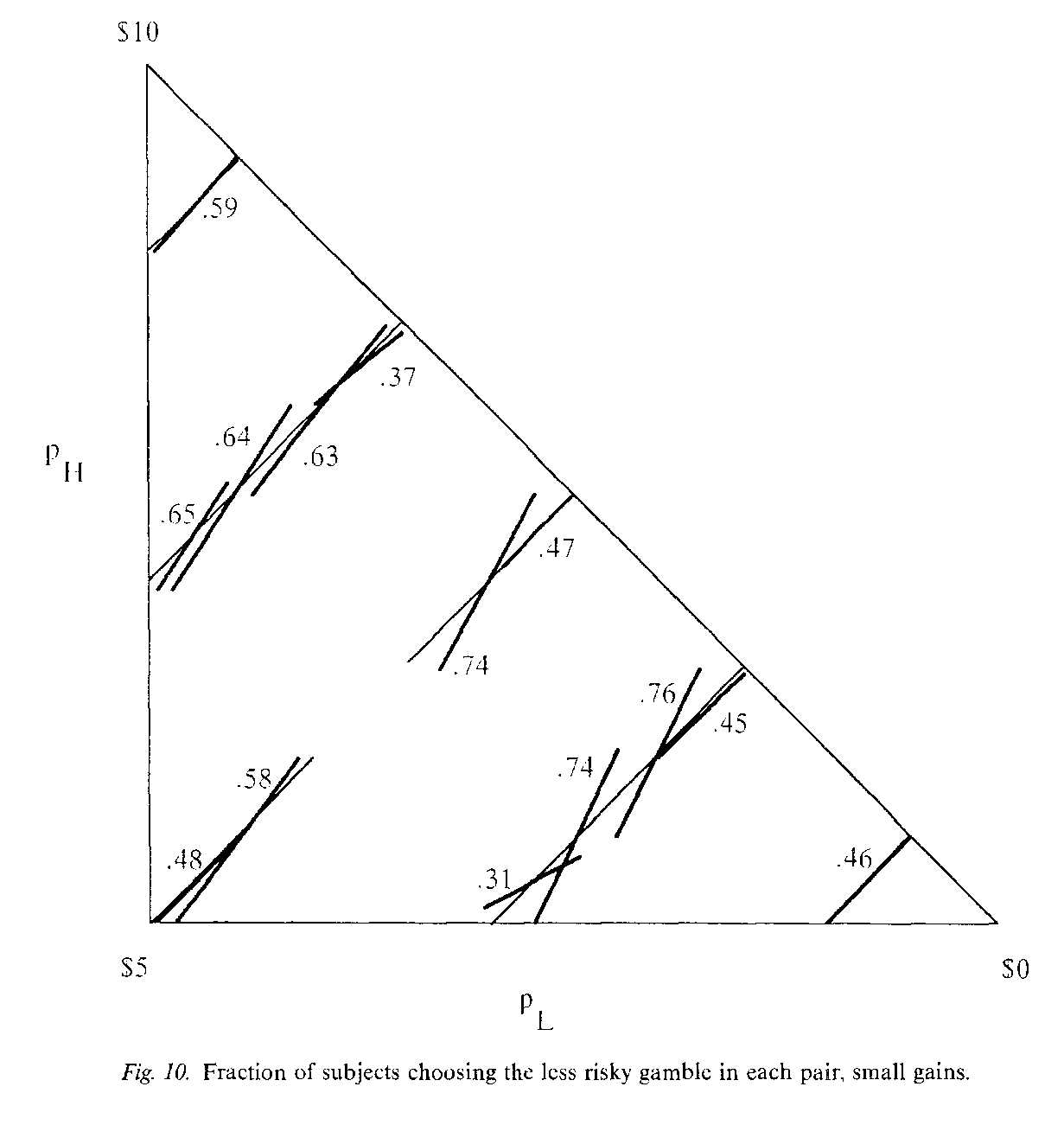

Slide 18
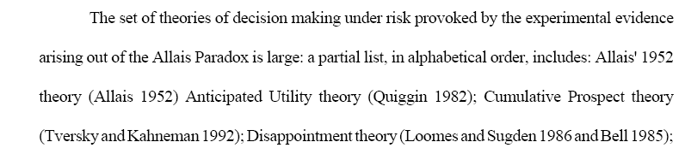
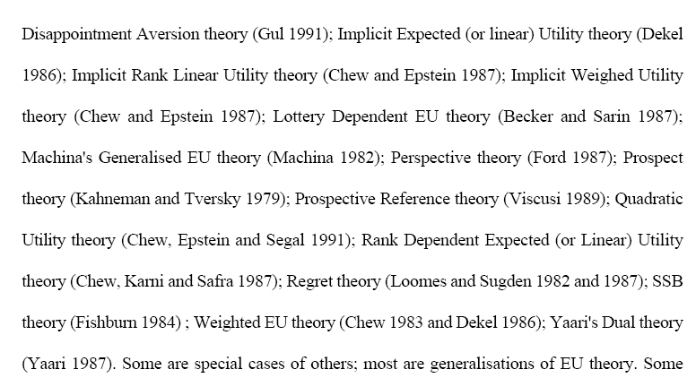
New Theories

Slide 19
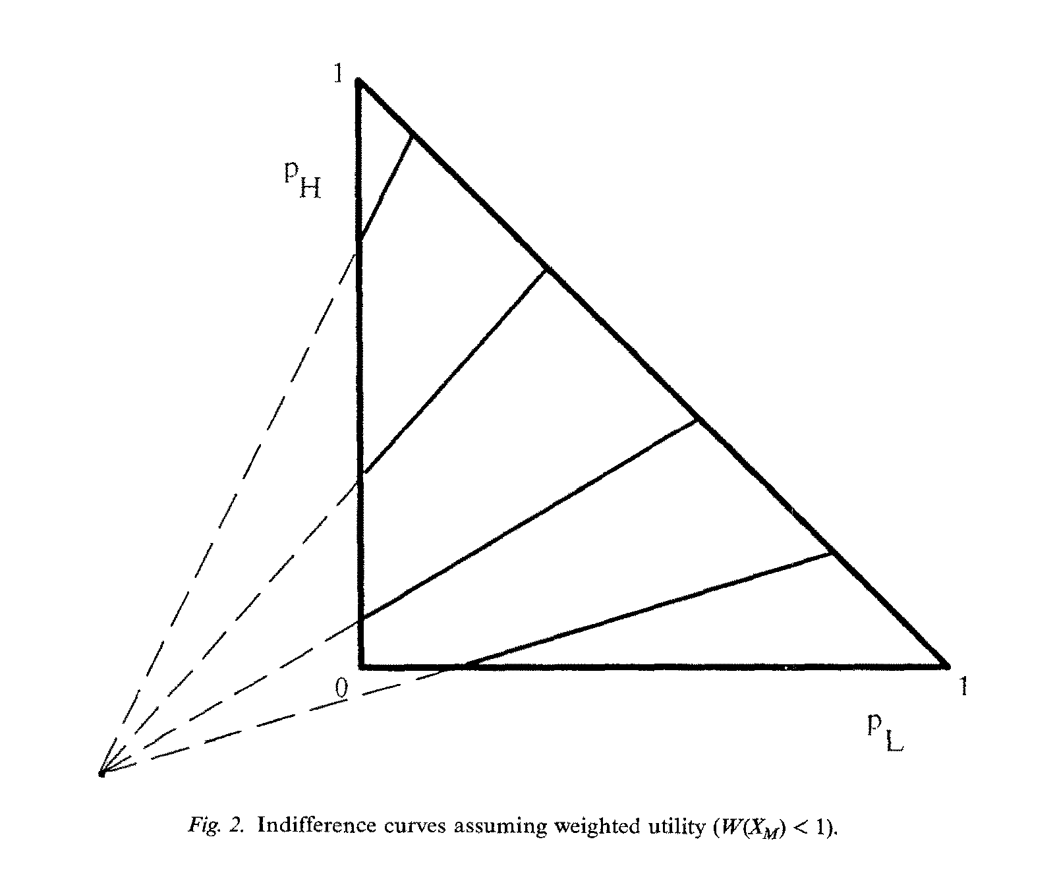

Slide 21
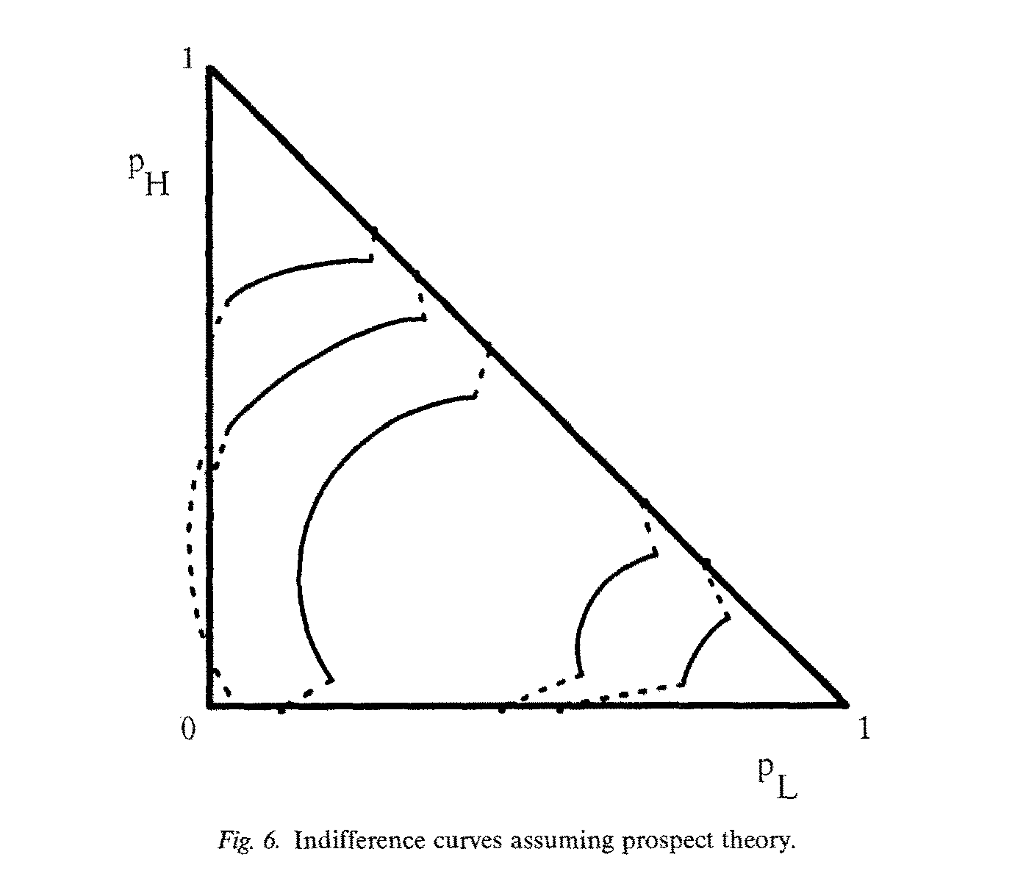

Slide 23
Experimental details
How many subjects?
Depends on how different people are.
How many problems per subject?
Depends upon how much noise in their behaviour.
How should the problems be chosen?
Depends what you want to test.
How should the lotteries be presented?
Might there be a ‘framing effect’?
How would you do the playout?

Slide 24
Presentation of lotteries

Slide 26
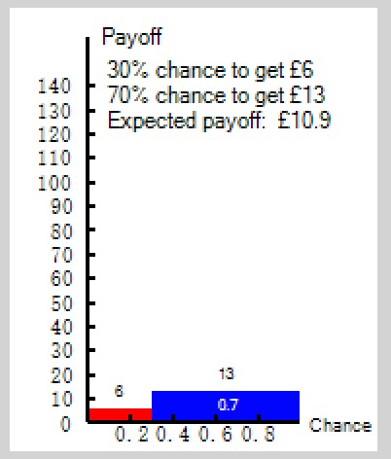
What I prefer now

Slide 27
Axioms and theories
All axioms are wrong.
All more general theories fit better than less general theories that are nested inside them.
Is this interesting or important?
How wrong are they?
How much better is the fit?
Statistical significance just tells you that you have enough data.
What is more crucial is economic importance.

Slide 28
Testing axioms or fitting preference functionals?
Theories are composed from sets of axioms.
Testing axioms enable us to discover which bits of theories are wrong.
How many violations of an axiom are enough to condemn it?
Fitting preference functionals enables us to see how well a theory fits the data.
But fitting preference functionals requires the specification of functional forms and the estimation of parameters.
Which is best?

Slide 29
Testing axioms experimentally – how?
Completeness
Transitivity
Independence
Continuity
Almost all of these relate to relationships between gambles.
The obvious way to start testing them is with pairwise choices – but these have to be specific.
So not testing the axiom as a whole (unless by asking? Would that work?)
How would one test the above axioms?

Slide 30
Estimating preference functionals
Up to now the literature was concerned with testing.
In 1994 with the papers by Harless and Camerer and by Hey and Orme, the focus shifted to estimation.
Fit preference functionals and see which fits best – taking into account degrees of freedom.

Slide 31
Hey and Orme (1995)
Estimating preference functionals: RN, EU, DA, PR, QU, RD, RI, RP, RQ, WU and YD.
80 subjects given 100 pairwise choice questions on two separate occasions.
All lotteries led to one of £0, £10, £20, £30.
Random lottery payment mechanism used on each occasion.

Slide 33
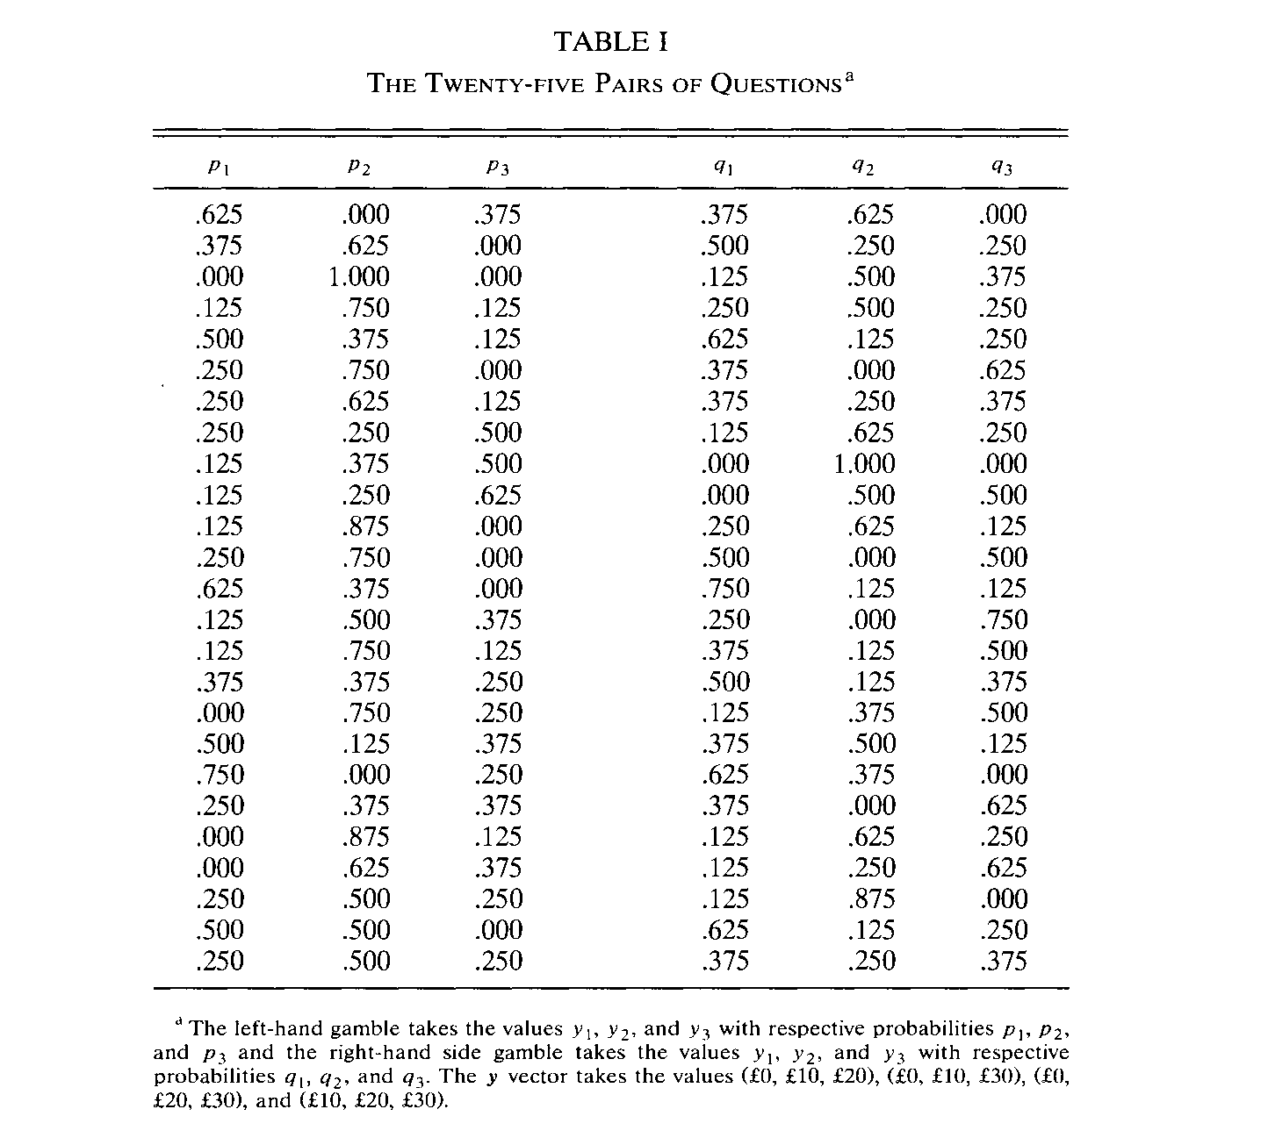

Slide 34
Stochastic assumptions
We assumed that choice is made on the basis of the true preference function plus error – Normal with mean 0 and s.d. s.
L stated as preferred to R if and only if V(L) – V(R) + e > 0.
(For subjects never indifferent)
What about indifference? Theshold t such that L and R stated as indifferent if
t > V(L) – V(R) + e > -t.
This is called the Random Utility Model (RUM)
An alternative is the Random Preference Model (RPM)
In this the parameter(s) r is/are random

Slide 35
Estimation
All the different preference functionals fitted/estimate using Maximum Likelihood.
Parameters of the models (depends how you characterise the utility ‘function’) plus the stochastic parameters estimated.
Models compared on the basis of their maximised log-likelihood corrected for degrees of freedom:
Aikake Criterion.

Slide 37
Harless and Camerer
They pool observations from lots of subjects.
They have a different error story – they assume that subjects state their preferred choice with a given probability.
This is called the ‘Tremble Story’.
Other error stories – for example, Loomes and Sugden assume stochastic preferences.

Slide 38
Recent work
Hey and Orme showed that “EU plus noise” is not a bad description of the data.
Problems with non-violation of dominance.
Clear that noise is not homoscedastic.
Blavatskky shows that an appropriately specified heteroscedastic model (with EU) is pretty good.

Slide 39
Conclusions on risk
In a sense we have come full circle.
The early tests of EU showed that it did not do too well...
...as a consequence lots of new models were formulated.
These were then estimated and attention focussed on ‘noise’...
...with appropriately specified noise, “EU plus noise” is not too bad.

Slide 40
A Digression
Does the elicitation mechanism affect the results?
See Zhou and Hey Context Matters, Experimental Economics, online 2017.
In this, we estimated the risk attitude of 96 subjects using 4 different elicitation methods:
Holt-Laury Price Lists (48 such lists)
Pairwise Choices (80 such pairs)
The Becker-DeGroot-Marshak method (modified) 54 problems
Allocation problems (81 such problems)

Slide 41
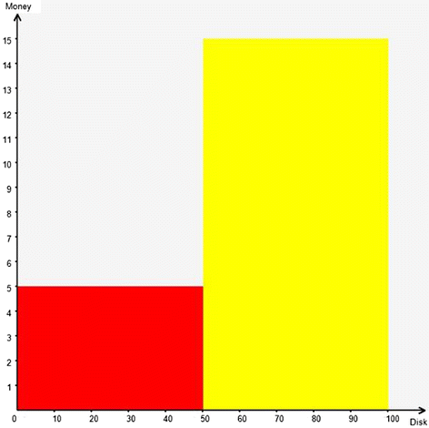
Our Presentation of a lottery

Slide 42
Results –a summary
The different elicitation methods produced widely divergent estimates of risk aversion. Some examples follow on the next slides (the scatters differ across the preference functional assumed).

Slide 43
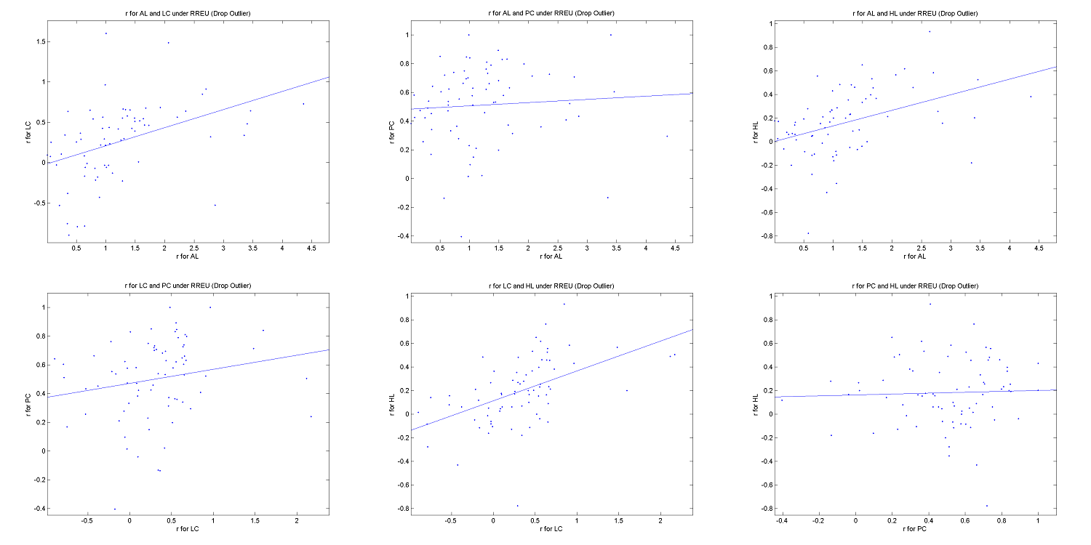
Expected Utility with Constant Relative Risk Aversion
Key: HL: Holt Laury; PC:Pairwise Choice; LC: Becker-DeGroot Marschak; AL: Allocation

Slide 44
Our Conclusion
Context Matters.

Slide 45
Behaviour under ambiguity
Recent years have witnessed many new theories of behaviour under ambiguity (where objective probabilities do not exist or are not known).
These are also based on axioms.
Testing and estimating these are difficult, mainly because of the difficulty of implementing ambiguity in the laboratory.
‘Ellsberg urns’ are difficult to implement because of subjects’ possible suspicion, and possible problems of the violation of ethical standards.
We use a Bingo Blower…
… which I will show you later.

Slide 46
Models of Behaviour under ambiguity
Subjective Expected Utility
Choquet Expected Utility
Cumulative Prospect Theory
Maxmin Expected Utility
α-maxmin Expected Utility
Confidence Function
Variational Preferences
The ‘Contraction’ Model
Smooth Ambiguity Model
Survey in Etner et al Journal of Economic Surveys 2012.

Slide 47
Experiments I have conducted on Ambiguity
Hey. Lotito and Maffioletti JRU (2010), The Descriptive and Predictive Adequacy of Theories of Decision Making Under Uncertainty/Ambiguity
Hey and Pace JRU (2014), The Explanatory and Predictive Power of Non Two-Stage-Probability Models of Decision Making Under Ambiguity.
Carbone, Dong and Hey, Elicitation of Preferences under Ambiguity, JRU (2017)

Slide 48
Hey. Lotito and Maffioletti
We used the BBB.
We had three treatments –with different amounts of ambiguity.
Pairwise choice questions – between ambiguous gambles with payoffs -£10, £10 and £100 (with a show-up fee of £10).
Random Payment mechanism

Slide 49
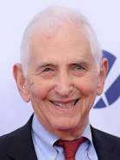
This experiment was inspired by Ellsberg
Let us suppose that you confront two urns containing red and black balls, from one of which a ball will be drawn at random. To "bet on Red I" will mean that you choose to draw from Urn I; and that you will receive a prize a (say $100) if you draw a red ball ("if Red I occurs") and a smaller amount b (say, $0) if you draw a black ("if not-Red I occurs"). You have the following information. Urn I contains 100 red and black balls, but in a ratio entirely unknown to you; there may be from 0 to 100 red balls. In Urn II, you confirm that there are exactly 50 red and 50 black balls. An observer – who, let us say, is ignorant of the state of your information about the urns – sets out to measure your subjective probabilities by interrogating you as to your preferences in the following pairs of gambles:
"Which do you prefer to bet on, Red I or Black I: or are you indifferent?" That is, drawing a ball from Urn I, on which "event" do you prefer the $100 stake, red or black: or do you care?”
"Which would you prefer to bet on, Red II or Black II?"
"Which do you prefer to bet on, Red I or Red II?"
"Which do you prefer to bet on, Black I or Black II?”

Slide 50
Hey. Lotito and Maffioletti
The following is a screenshot of one problem from the experiment.
They were all pairwise choice questions

Slide 51
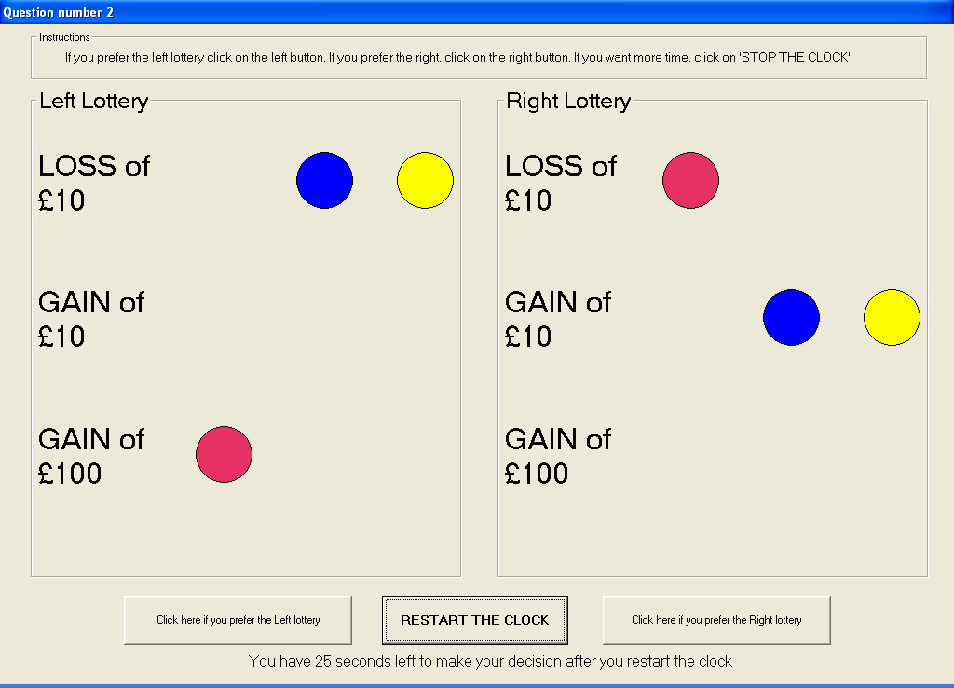

Slide 52
The Treatments
Treatment 1: 2 pink, 5 blue, 3 yellow
Treatment 2: 4 pink, 10 blue, 6 yellow
Treatment 3: 8 pink, 20 blue, 12 yellow
In Treatment 1, the balls can be counted.
In Treatment 2, the pink can be counted and possibly the yellow but not the blue.
In Treatment 3, no colour can be counted.

Slide 53
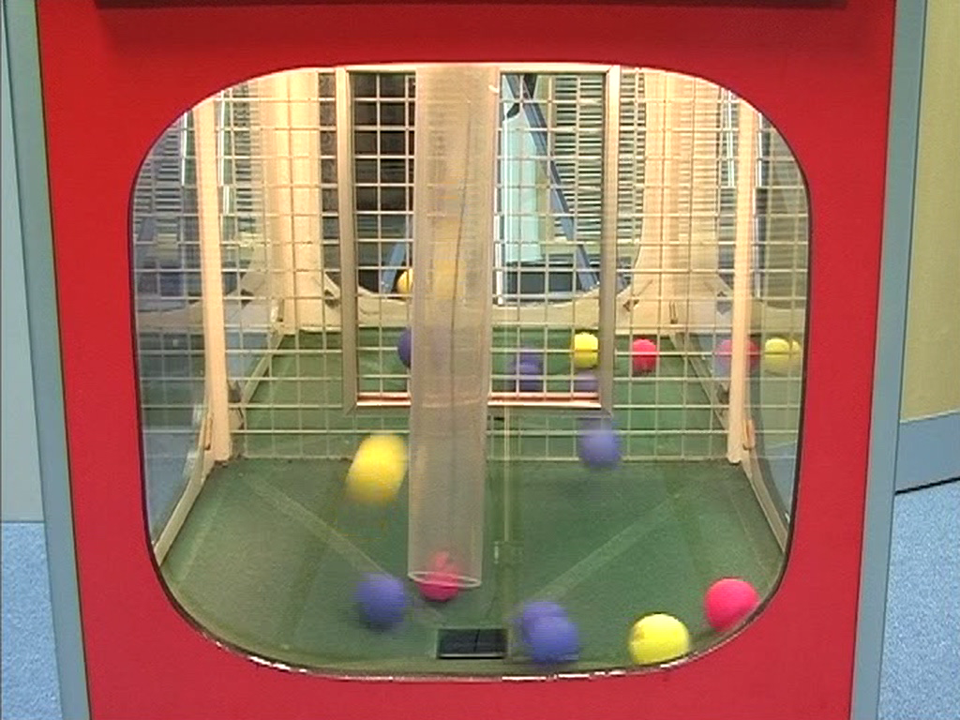

Slide 54
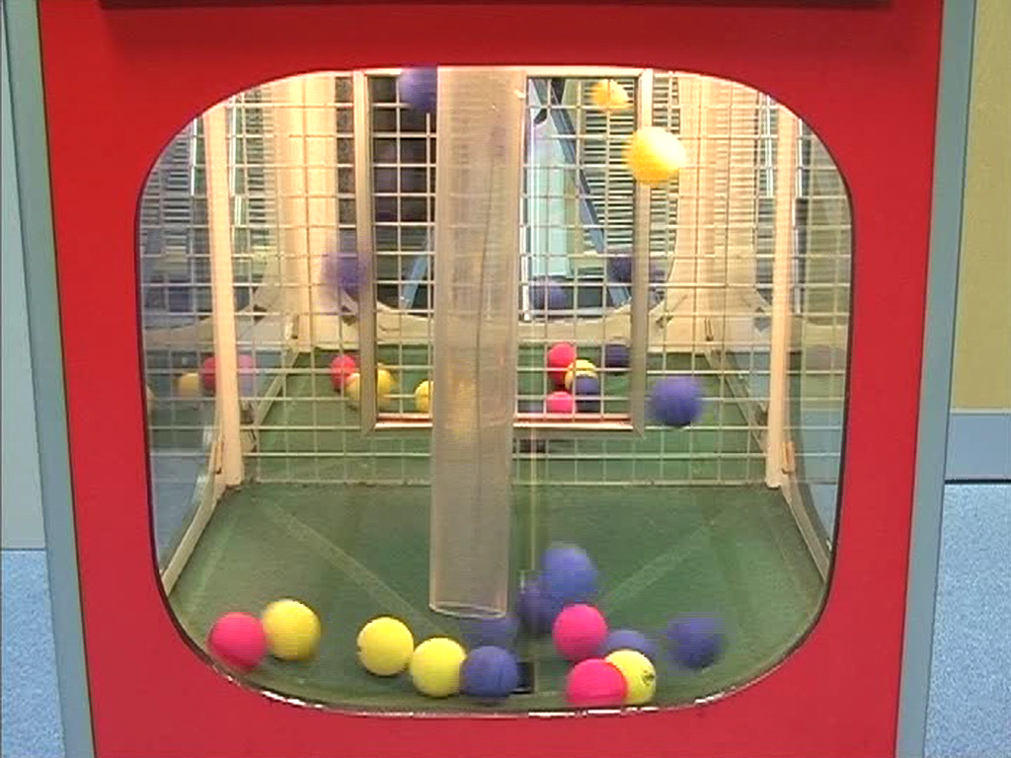

Slide 55
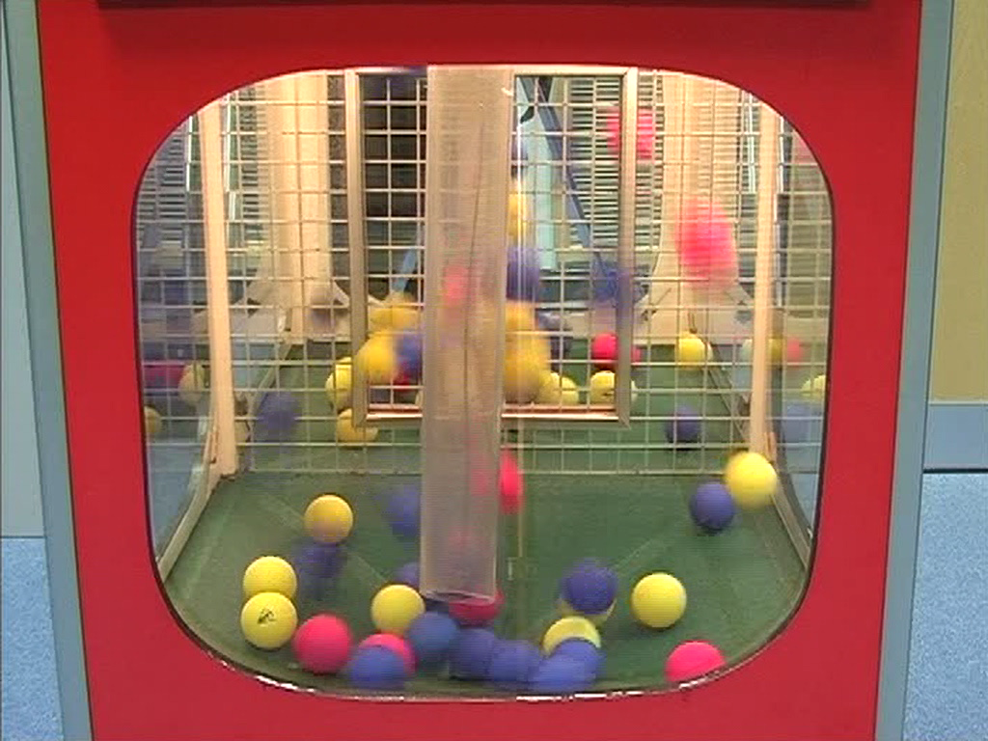

Slide 56
The Design
Participation fee of £10.
3 colours (pink, blue and yellow) .
3 amounts of money (-£10, £10 and £100).
Pairwise choice questions.
3³ = 27 different lotteries and hence 27x26/2 = 351 possible pairwise choices.
Omitting those with dominance leaves us with 162 pairwise choice questions.
Order and left-right juxtaposition randomised.

Slide 57
The Preference Functionals No Multiple Prior Models
Subjective Expected Utility (SEU)
‘Prospect Theory’ (PT)
Choquet Expected Utility (CEU)
Cumulative Prospect Theory (CPT)
Decision Field Theory (DFT)
Gilboa and Schmeidler’s MaxMin Expected Utility theory (GS Min)
Gilboa and Schmeidler’s MaxMax Expected Utility theory (GS Max)
The Alpha EU Model (Ghiradarto et al)
Maximin
Maximax
Minimax Regret
Hurwicz Model

Slide 58
Estimation of Models
All preference functionals parameterised.
Stochastic Specifications:
(1) For the models which have a preference functional we assume that preferences are measured with error such that the differences in the evaluations of the two lotteries is N(0, s²). We estimate s along with the other parameters.
For the DFT model the errors are not homoscedastic but have a variance which depends on the lotteries.
(2) For the other models, the not-preferred choice is implemented with probability w.
We estimate w along with the other parameters.
We estimated using Maximum Likelihood in GAUSS
We also used the data to predict (out-of-sample)

Slide 59
Conclusions 1
We can dismiss CEU, CPT, Minimax Regret and the Hurwicz Criterion.
GS Max is best only once and Alpha only one-and-a-half times.
Of the remaining models, clearly the best are PT and DFT, while EU, GS Min, MaxMin and MaxMax score almost equally.
As we go from Treatment 1 through Treatment 2 to Treatment 3, we note that there is a very slight evidence of an increase in the ‘rules of thumb’, MaxMin and MaxMax; also interestingly and counter-intuitively, EU seems to improve, with a corresponding decline in PT.

Slide 60
Conclusions 2
The simpler models seem to do better.
What about the Multiple Prior models?
Many more parameters to estimate.
There is an identification problem.
Perhaps people prefer to simplify a complicated problem rather than apply a complicated decision rule?

Slide 61
Hey and Pace
We used the allocation method to elicit preferences (thinking it might be better than pairwise choices).

Slide 62
The Experiment
We asked the subjects a total of 76 questions
There were two types of question:
1. The first type of question was to allocate a given quantity of tokens between two of the three colours in the Bingo Blower
2. The second type of question was to allocate a given quantity of tokens between one of the three colours in the Bingo Blower and the other two

Slide 63
The First Type of Question
In this type we gave the subject a given quantity of tokens and asked him or her to allocate them between two of the three colours in the Bingo Blower
That is, between pink and blue, or between blue and yellow, or between yellow and pink
We also told the exchange rate between tokens and money for each colour
An allocation of tokens between the two colours implies an amount of money for each of the two colours

Slide 64
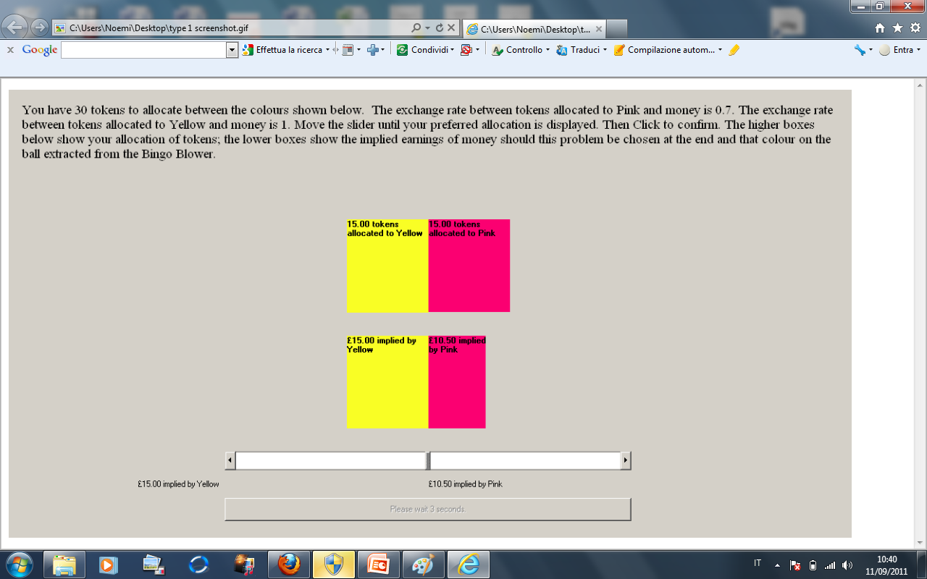

Slide 65
The Second Type of Question
In this type we gave the subject a quantity of tokens and asked him or her to allocate them between one of the three colours in the Bingo Blower and the other two
That is, between pink and not-pink (that is, blue and yellow), or between blue and not-blue (that is, yellow and pink), or between yellow and not-yellow (that is, pink and blue)
We also told the exchange rate between tokens and money for each colour
An allocation of tokens between the one colour and the other two implies an amount of money for the one colour and the other two

Slide 66
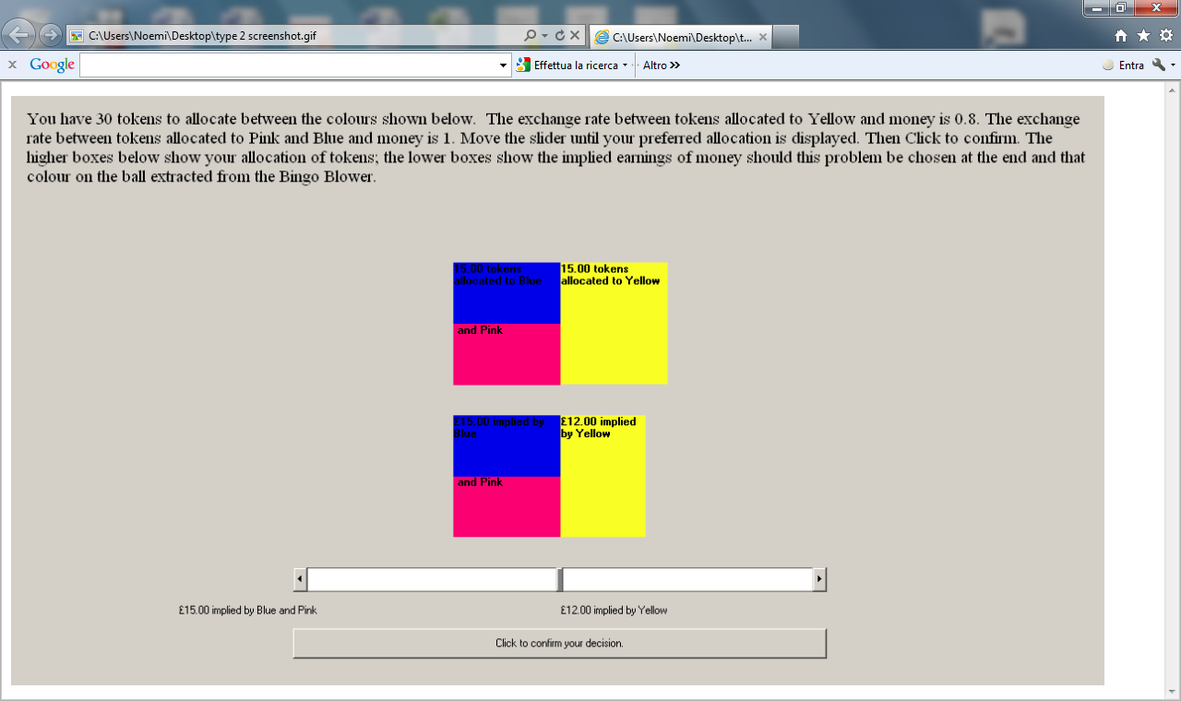

Slide 67
Payment
At the end of the experiment, for each subject, one of the 76 questions was picked at random
The subject then ejected one ball from the Bingo Blower (he or she could not manipulate the ejection)
Its colour determined their payment, as we show in the following slides

Slide 68
Payment if this problem is selected at random
If the ball ejected was yellow you would get paid £15.00, if the ball ejected was pink you would get paid £10.50 and if the ball ejected was blue you would get paid nothing

Slide 69
Payment if this problem is selected at random
If the ball ejected was pink you would get paid £15.00, if the ball ejected was blue you would get paid £15.00 and if the ball ejected was yellow you would get paid £12.00

Slide 70
Result: Precision increases
PARAMETER OF PRECISION | First 38 Q | Last 38 Q | t-stat diff
Overall | 12.818 | 15.320 | -3.068
Treatment 1 | 13.687 | 16.100 | -2.505
Treatment 2 | 11.909 | 14.502 | -1.939
Precision increases significantly during the experiment, expecially in Treatment 1 (less ambiguous)

Slide 71
Result: Precision increases
 |  | First 38 Q | Last 38 Q | t-stat diff
SEU | Treatment 1 | 12.796 | 15.028 | -2.542
 | Treatment 2 | 11.291 | 13.495 | -1.748
CEU | Treatment 1 | 13.985 | 16.711 | -2.760
 | Treatment 2 | 12.188 | 14.690 | -1.844
AEU | Treatment 1 | 13.827 | 16.508 | -2.668
 | Treatment 2 | 12.024 | 15.017 | -2.111
VEU | Treatment 1 | 14.678 | 16.937 | -1.960
 | Treatment 2 | 12.674 | 15.727 | -2.108
COM | Treatment 1 | 13.148 | 15.318 | -2.390
 | Treatment 2 | 11.367 | 13.583 | -1.725

Slide 72
Result: Risk Aversion does not change
RISK AVERSION | First 38 Q | Last 38 Q | t-stat diff
Overall | 0.795 | 0.799 | -0.251
Treatment 1 | 0.794 | 0.815 | -1.078
Treatment 2 | 0.796 | 0.783 | 0.444
The changes are not statistically significant

Slide 73
Result: Risk Aversion does not change
73
 |  | First 38 Q | Last 38 Q | t-stat diff
SEU | Treatment 1 | 0.800 | 0.817 | -0.863
 | Treatment 2 | 0.803 | 0.789 | 0.512
CEU | Treatment 1 | 0.800 | 0.817 | -0.797
 | Treatment 2 | 0.797 | 0.773 | 0.818
AEU | Treatment 1 | 0.785 | 0.810 | -1.270
 | Treatment 2 | 0.788 | 0.779 | 0.313
VEU | Treatment 1 | 0.783 | 0.808 | -1.314
 | Treatment 2 | 0.779 | 0.778 | 0.060
COM | Treatment 1 | 0.803 | 0.819 | -0.868
 | Treatment 2 | 0.804 | 0.789 | 0.507

Slide 74
Results
74
Test for CEU: Additivity of capacities REJECTED
Test for AEU: Additivity of probabilities and lower ambiguity aversion REJECTED
Test for VEU: lower ambiguity aversion REJECTED
Test for COM: Additivity of probabilities and lower ambiguity aversion REJECTED

Slide 75
Carbone, Dong and Hey
This was expressed as a Portfolio Choice Problem.
Subjects were asked to allocate 100 tokens to 3 assets with stated rates of return.

Slide 76
Portfolio Choice Problem
Decision Maker (DM) has 100 to allocate between cash and assets 1 and 2
Allocations: c1, c2, and c0=100- c1- c2
Portfolio Payoff : dj=c0 +r1,jc1+r2,jc2, (in state j=1,2,3)
 | State 1 | State 2 | State 3
Asset 1 | r11 | r12 | r13
Asset2 | r21 | r22 | r23
Notes:
Abosolute return
Two assets
Three states
Arrow Assets

Slide 77
Conclusions
MV did rather badly
SEU does quite well
Subjects do not use a more complicated preference functional when choosing allocations in a complicated setting
SF worse than SEU
Some sophistication in decision making

Slide 78
Conclusions on experiments on ambiguity
The overall conclusion must be that the sophisticated theories of behaviour under ambiguity are too sophisticated for human beings.

Slide 79
That is the end of lecture 11 on individual decision-making.

